Slide 1
Streamlining Enterprise AI RAG Pipelines with OPEA and IBM DataPrepKit
Murilo Gustineli
Ezequiel Lanza
Sujee Maniyam
AI Engineer
Developer Advocate
@ Node51
Open Source AI Evangelist
@ Intel
Senior AI Software Engineer
@ Intel

Slide 2
GenAI is emerging rapidly, but enterprises are struggling to realize GenAI value in production.
Notes:
Introductions.
Innovation in the field of AI is moving rapidly, and everyone from large enterprises, to small startups to individuals, including developers are incredibly excited to jump in to reap the emerging benefits of generative AI for productivity and to integrate into new and applications. But with so much excitement and innovation comes a few challenges and even hurdles. Today we’ll go over a few of the problems that arise from rapid innovation in pioneering technology
Challenge is to convert from prototype to actual applicatio.

Slide 3
Open Platform for
Enterprise AI (OPEA)

Slide 4





Life is easier when things go together
Why standardization matters
Notes:
When We’re focused on rapid innovation, especially in pioneering fields, we may be focused on a goal, on a minimum viable product, getting some functionality out the door. But what is sometimes lost in that drive is the foresight to apply principles that lead to interoperability and flexibility.
And in emerging fields where best practices and modular architectures have not yet been established, that lack of established best practices and standardization slows down developement processes. AI development is like the wild west, with everyone reinventing the wheel in silos. So what we’d like to see is adoption of community-established standards to smooth and speed up everyone’s development workflows.
I think we’re all open source people here. This is the open source way. We come together to establish the best way, and the vendor-neutral way.
So Eze, Generative AI development isn’t exactly new per se. How did we get here?

Slide 5


Open source platform that organizes GEN AI chaos
Composable building blocks for generative AI systems
Integrates LLMs, data stores, and prompt engines RAG AI blueprint with component stack structure and end-to-end workflow
Additional stacks for translation, code generation, images
Generative AI assessment tool for performance, features, trustworthiness and enterprise-grade readiness
Notes:
E: Introduce OPEA
As enterprises seek to achieve their AI goals, they are looking for simplicity and total cost of ownership savings in their deployment. Being Open is the key to having control over what you do.
Better collab, thing are not attached to a company, support of the community . Each decision you take now will afftect how your future will be.
When we deploy GenAI in an enterprise , things can get pretty chaotic with all the moving pieces involved. It’s a bit of a puzzle.
But what if we simplify it by thinking of each part as a separate block?
By doing that, we can handle and integrate each piece on its own, making the whole process a lot smoother. That’s really what OPEA is all about. giving us a framework to make GenAI implementations more straightforward and manageable. It’s an LF project and started just a few months ago from an Intel research project.

Slide 6
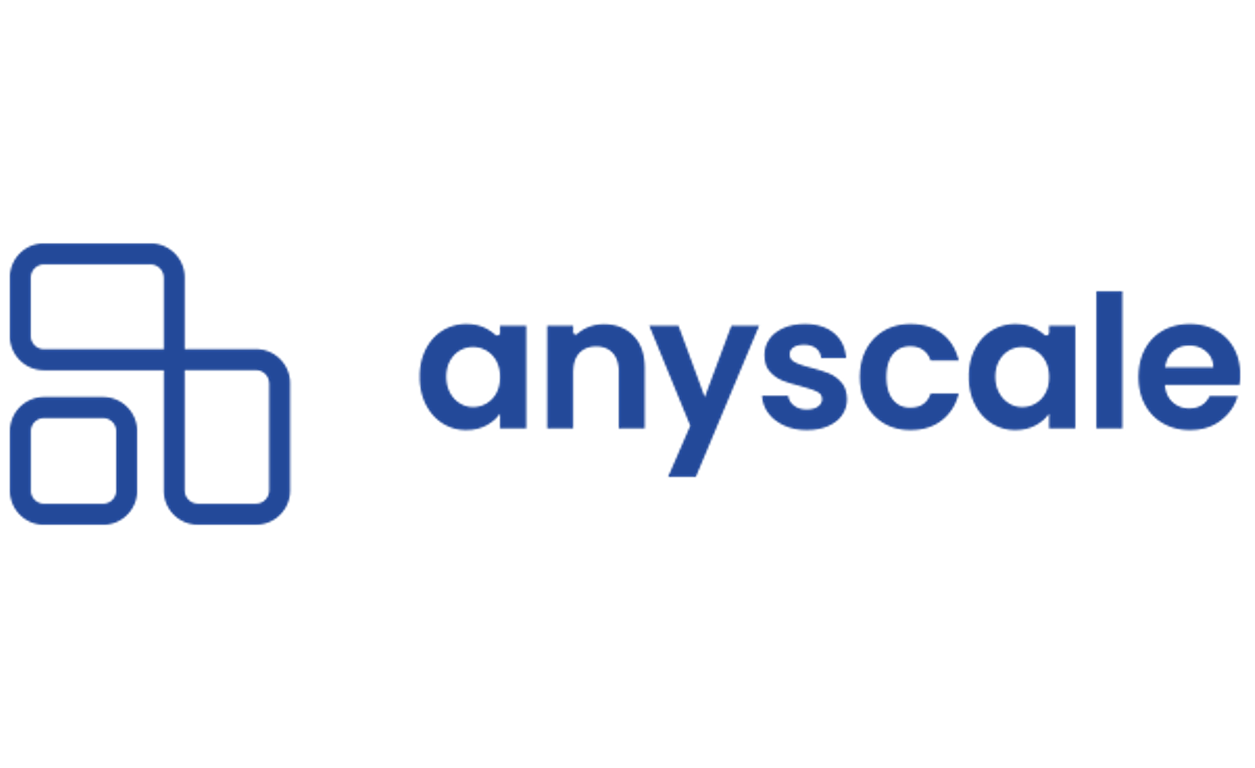












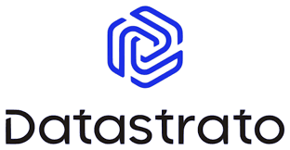




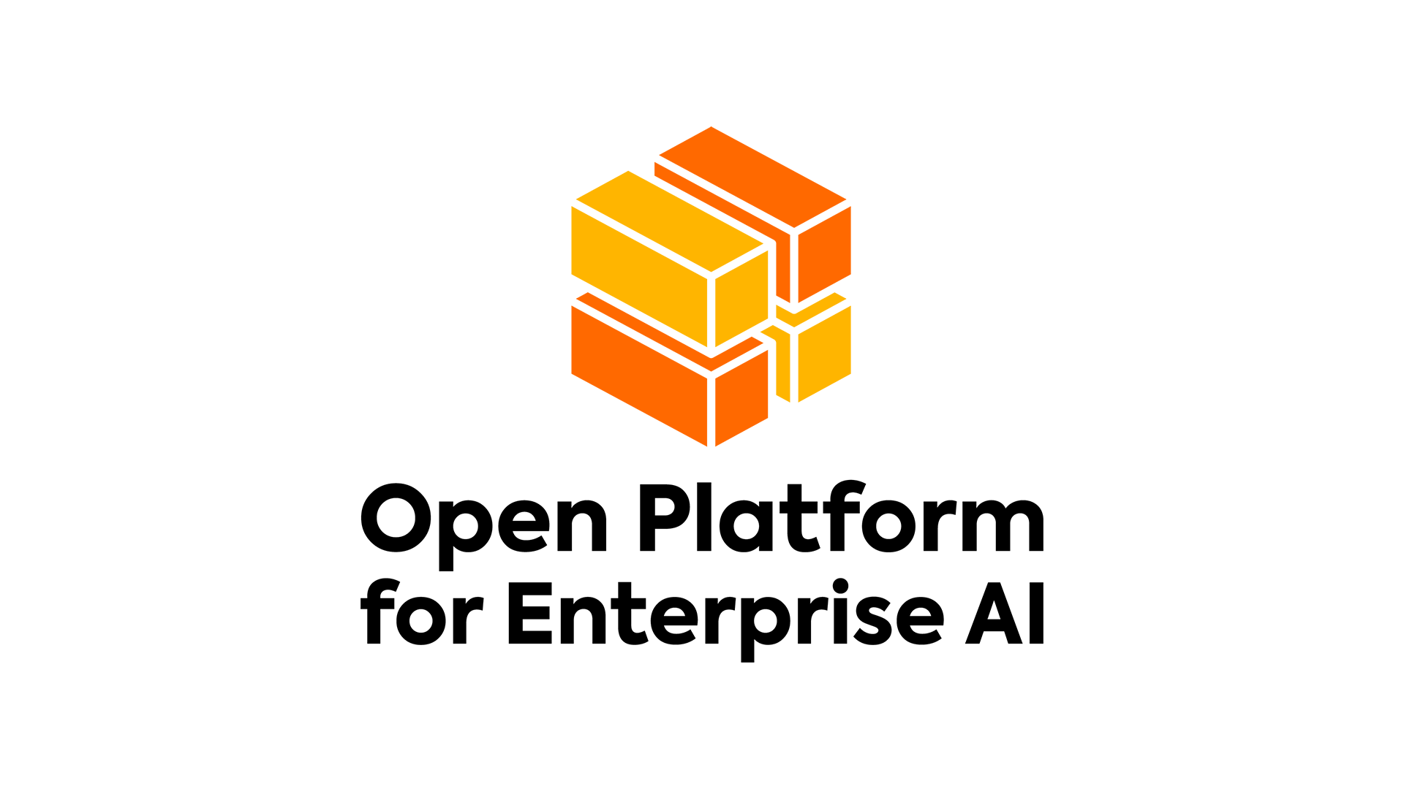



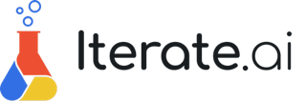








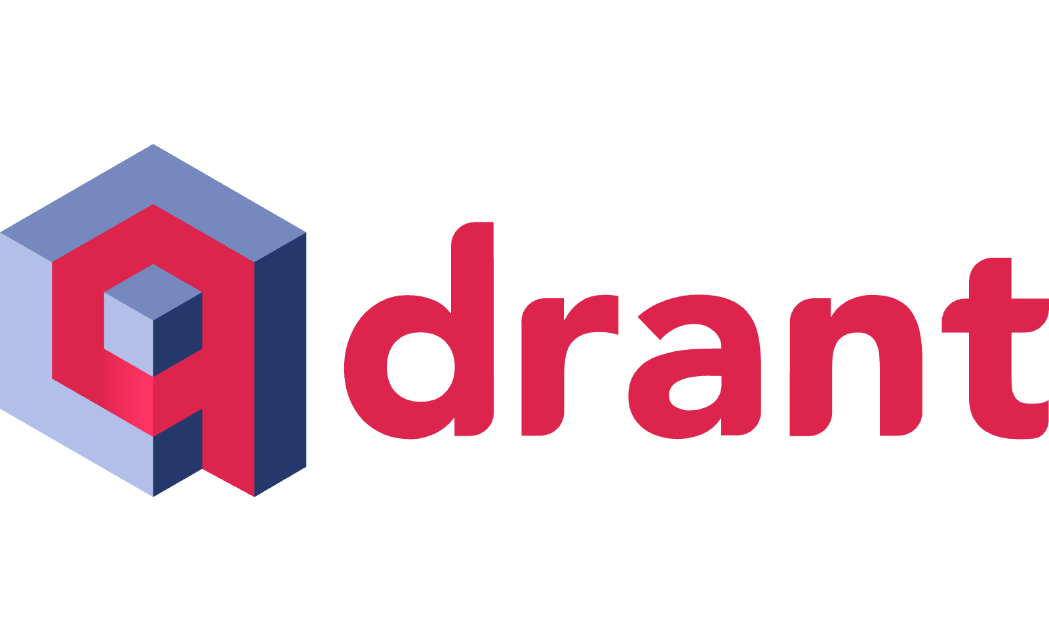









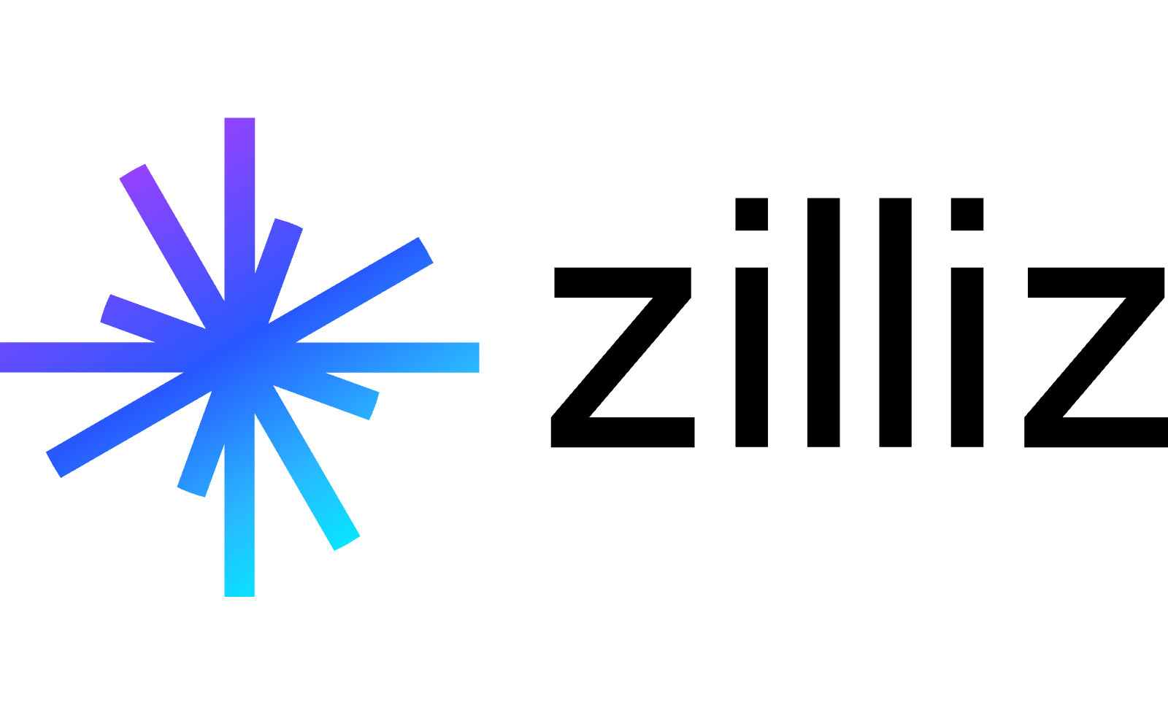

OPEA Contributors
Notes:
K: We are from Intel, but this is not just an Intel effort. All of these lovely folks have joined us to collaborate on this platform to ensure interoperability, best practices and extensibility

Slide 7

OPEA ChatQnA microservices blueprint
Additional context
Data Prep microservice
Embeddings microservice
VectorDB microservice
Embeddings microservice
Embeddings microservice
Retriever microservice
Reranking microservice
LLM microservice
Answer
Questions
🧠
Retrieval
✨
Augmentation
🤩
Generation

Slide 8
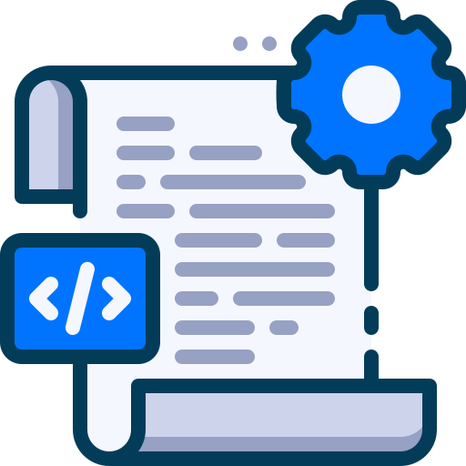
OPEA ChatQnA microservices with DataPrepKit ingestion
Additional context
DataPrep cleaning
script
Data Prep microservice
Embeddings microservice
VectorDB microservice
Embeddings microservice
Embeddings microservice
Retriever microservice
Reranking microservice
LLM microservice
Answer
Questions
🧠
Retrieval
✨
Augmentation
🤩
Generation

Slide 9
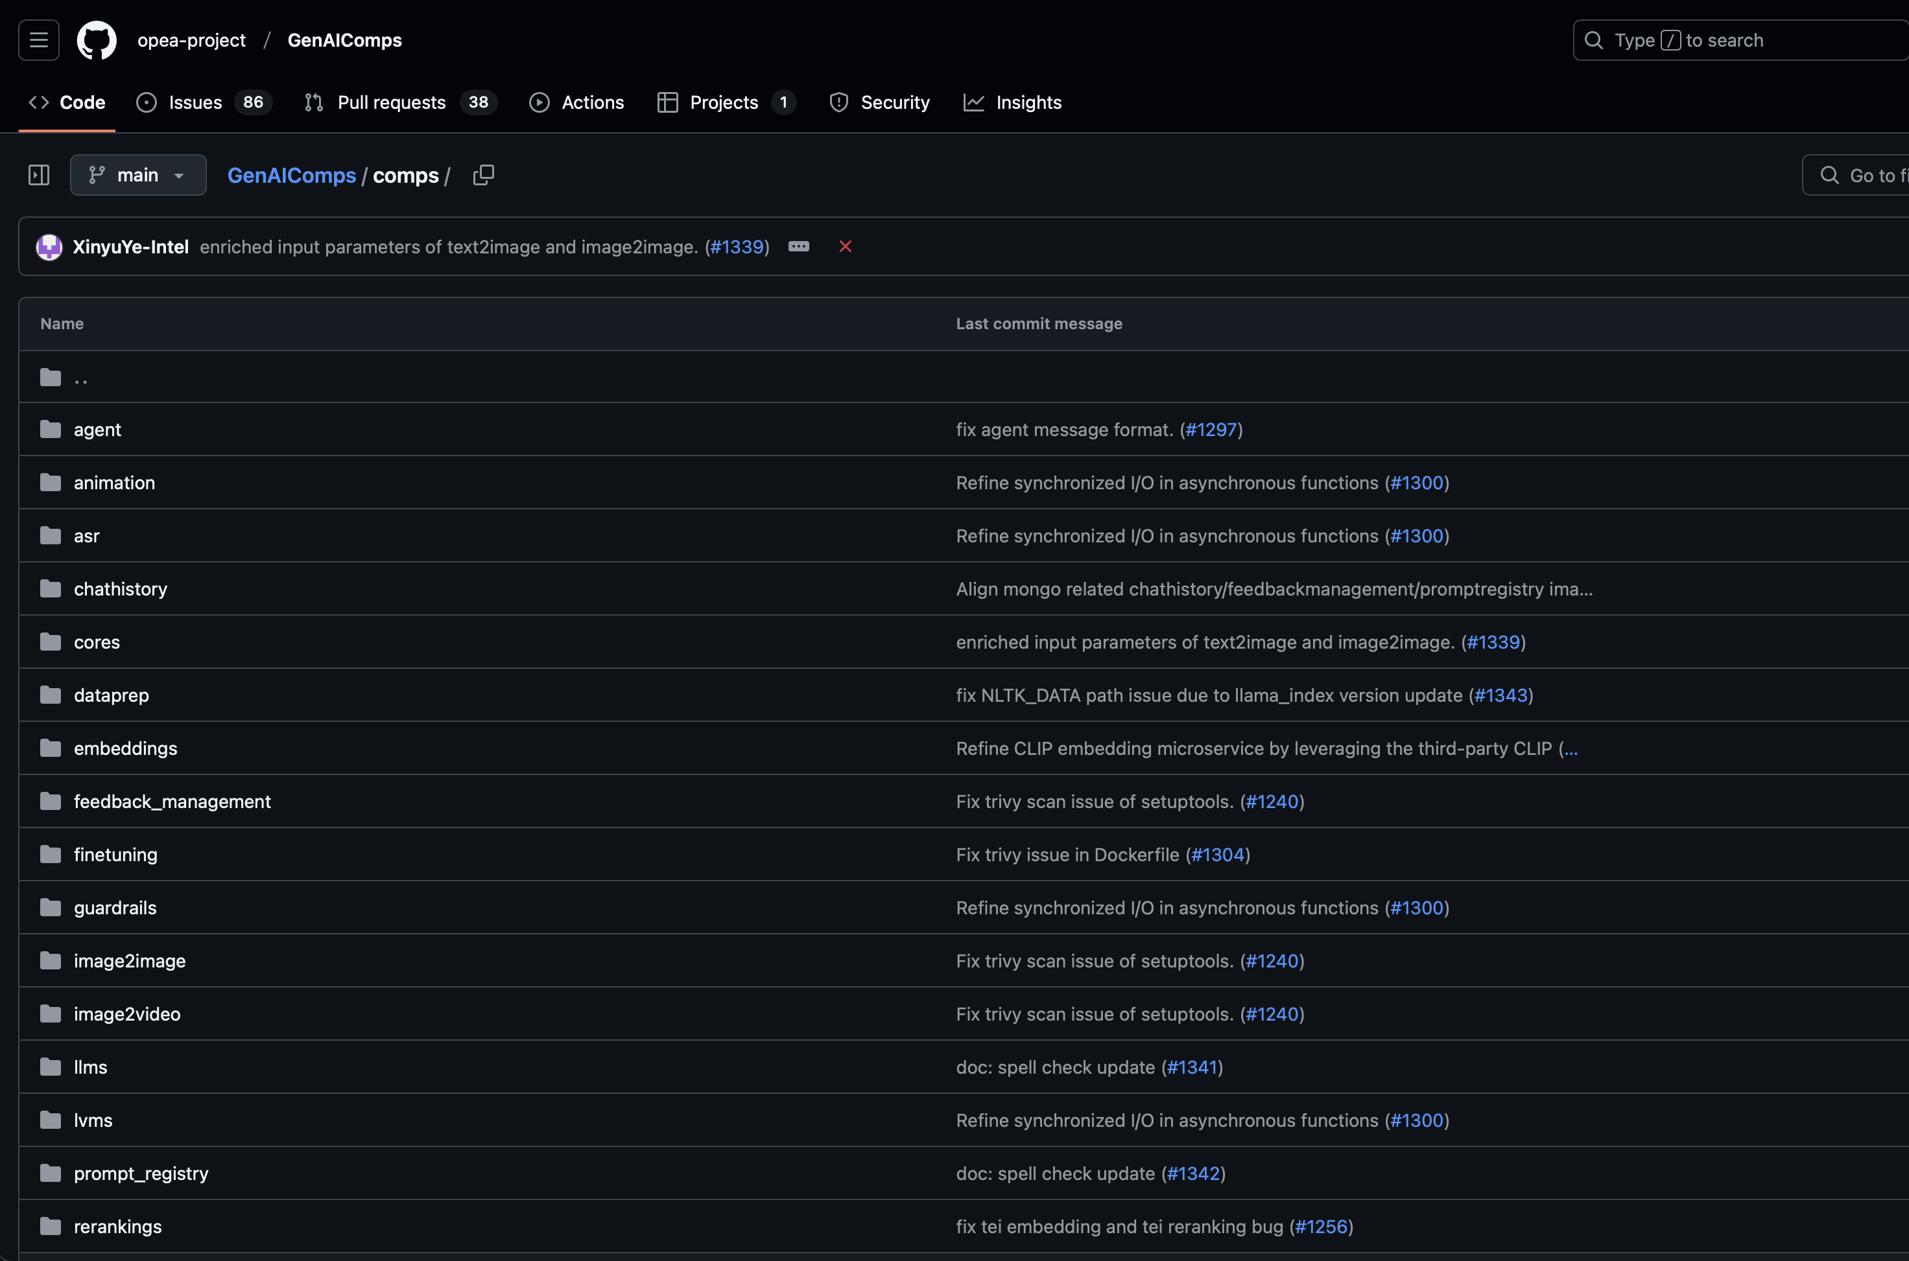
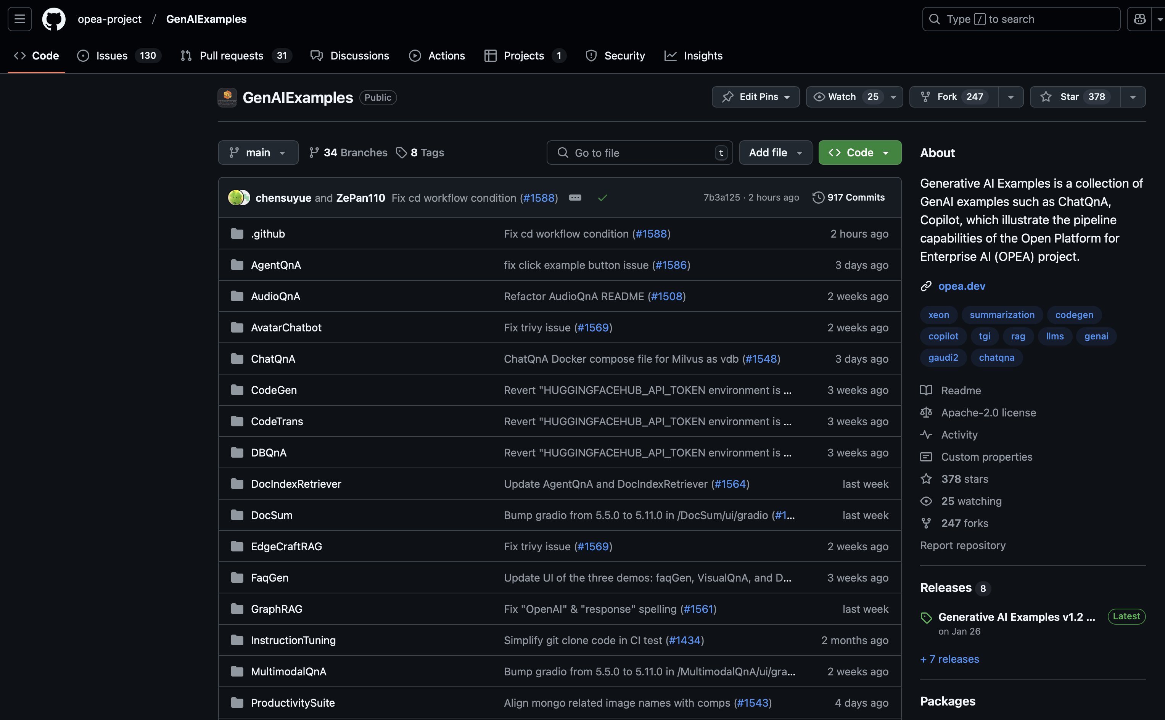
Blueprints and Components

Slide 10
DataPrep kit

Slide 11
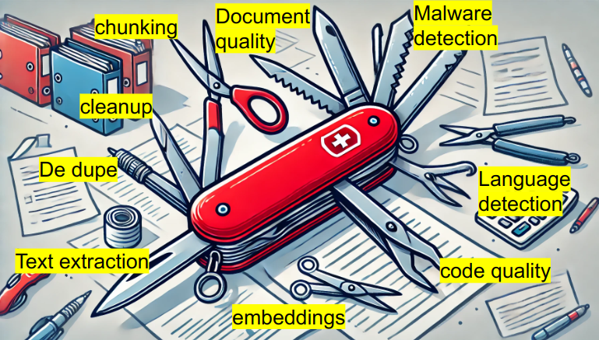
Say Hello to "Data Prep Kit"
Open source toolkit
Helps with data prep
Handles documents + code
Many ready to use modules out of the box
Python
Develop on laptop, scale on clusters
images created by chatGPT

Slide 12
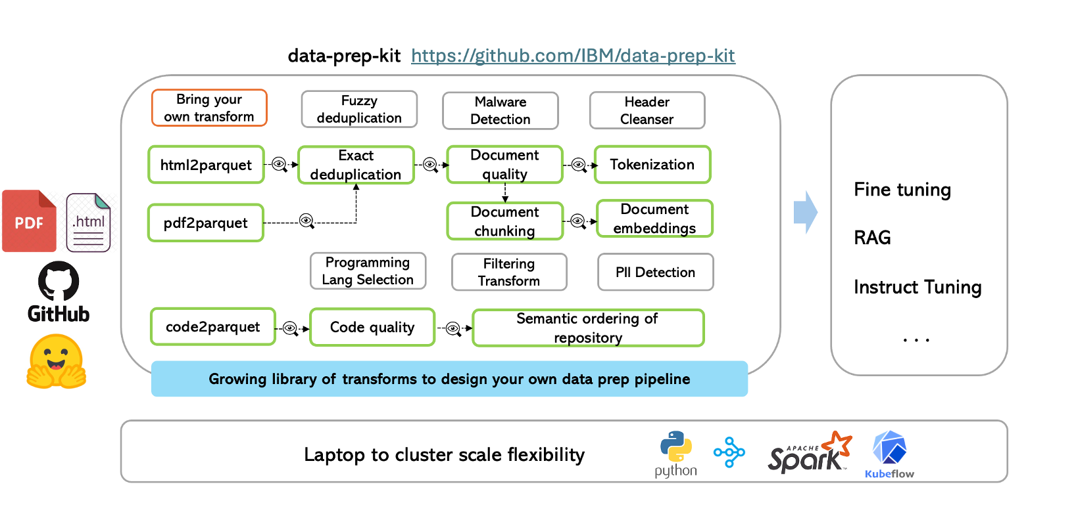
Data Prep Kit

Slide 13
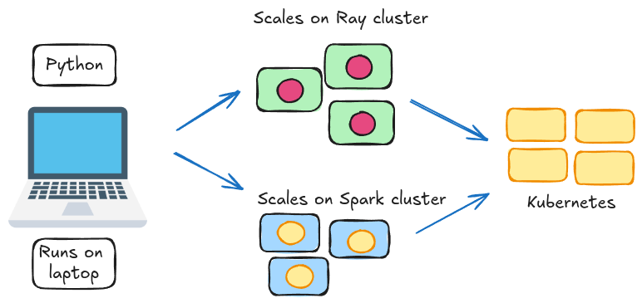
Built for ease of use and scale
Built on python
Develop on a laptop
Deploy on a cluster
RAY
Spark
Scales to TBs of data across 1000s of CPU cores

Slide 14
Workshop!

Slide 15

Log into Intel Tiber AI Cloud to access to your env

Slide 16
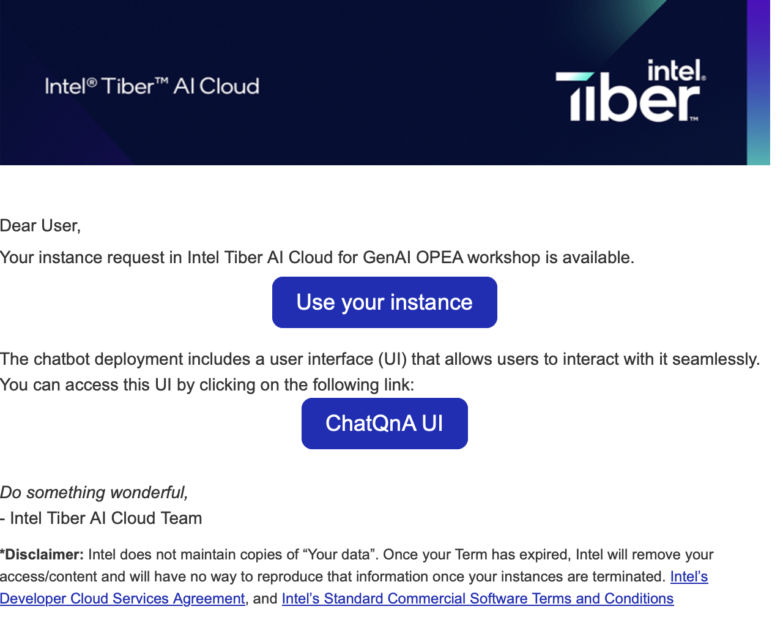
Access to your preprovisioned environment
Once you are approved and your environment is ready, you will receive the following email:
Button to access to your console
Link to access to ChatQnA console

Slide 17
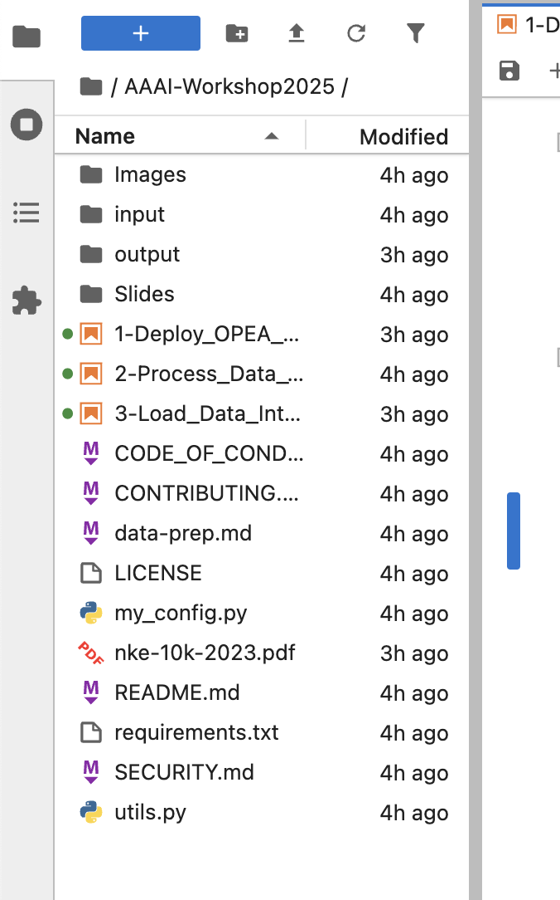
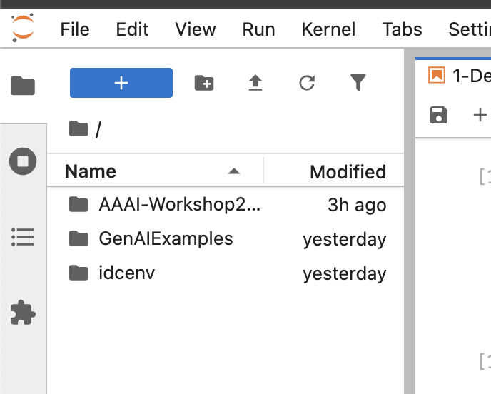
Start

Slide 18
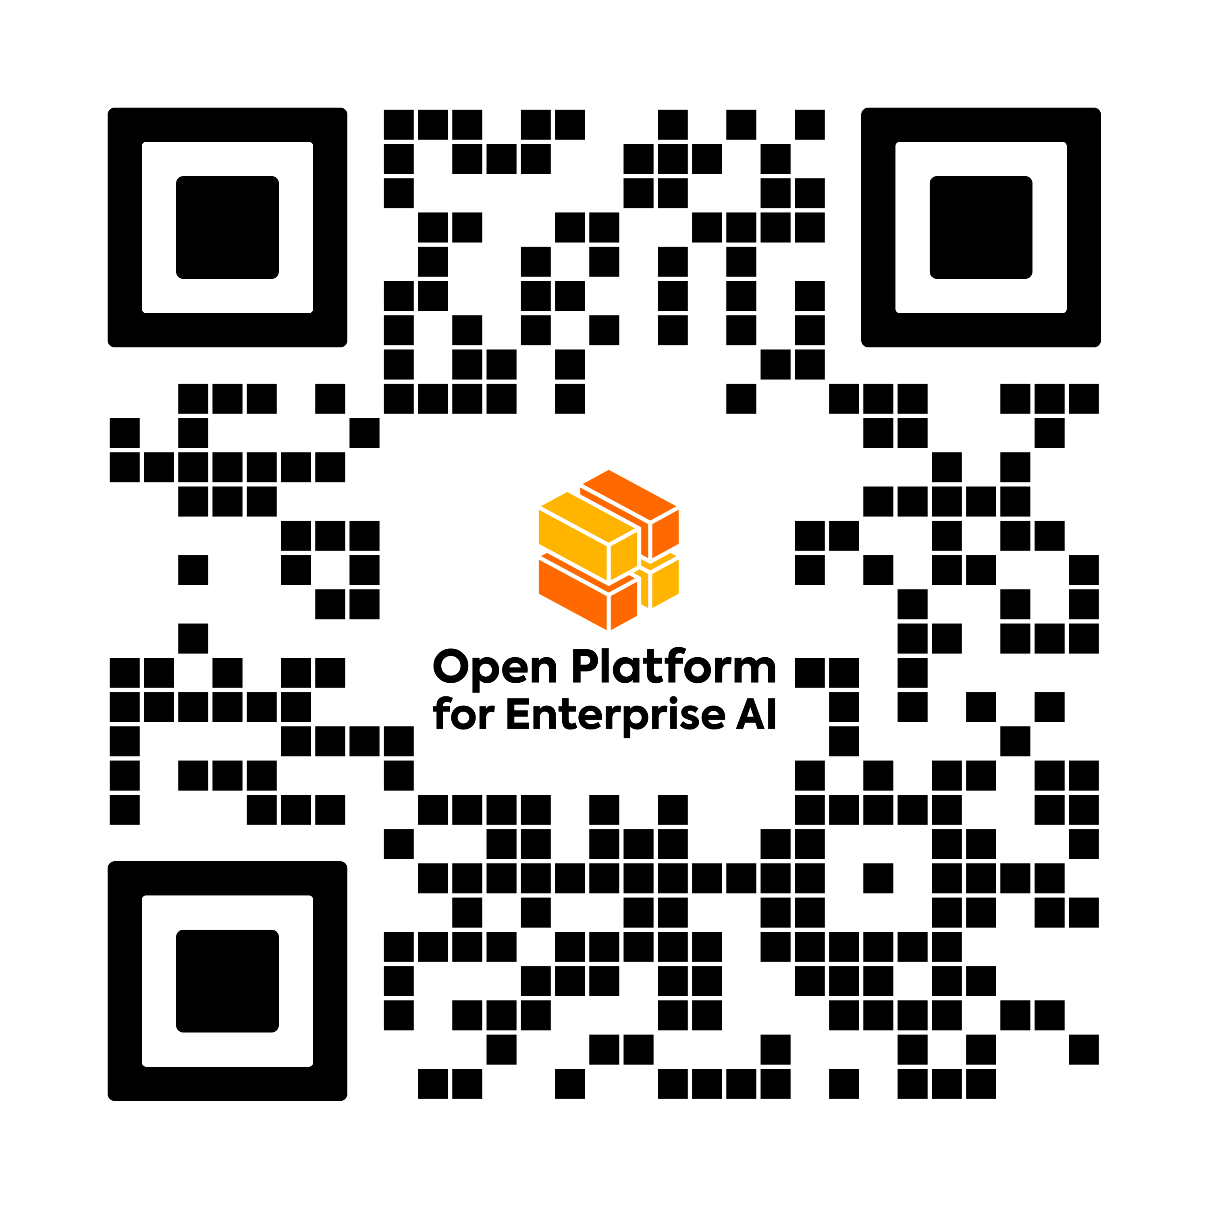


Resources
Public Workshop Repo (Github)
Open Platform For Enterprise (OPEA)
DataPrep kit

Slide 19

Participate in OPEA
Join a Working Group
Bring Enterprise AI use cases
Contribute code, docs, projects, blueprints, and more
Provide feedback
Evangelism and Promotion of OPEA in YOUR communities, events
Visit OPEA.dev
Notes:
Just OPEA.dev. You can get everywhere else from there.

Slide 20


Scan for tools, sources, and resources
Visit the Intel Open Ecosystem Community and Evangelism GitHub page
A PDF of this presentation
Guides and community resources
Links to articles and source material

Slide 21
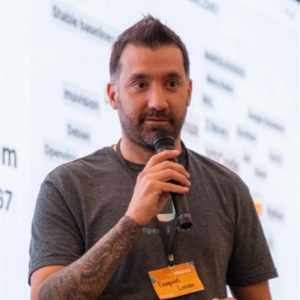
Where to find Ezequiel
LinkedIn: /ezelanza
Fediverse: @eze_Lanza@mstdn.ca
Twitter/X: @eze_lanza

Slide 22
Thank you!
Open Platform for Enterprise AI

